Slide 1







Sold by T-Mobile Rep
Authorized Reseller & Installer
www.mvcsol.com
Copyright © 2023 Mobile Video Computing Solutions
Confidential

Slide 2



Who We Are
Mobile Video Computing Solutions
Founded 1997
Innovation Leader in Mobile Video Solutions
6 Patents supporting industry specific solutions
Nationwide Installation Services with Customizable Options
Confidential

Slide 3
Tow Operators
Towing is a dangerous business
Extremely high incidence of injury and fatalities.
Safety, Prevention and Defense are key factors for success.
Video Helps
Video helps train and supervise drivers to improve safety!
Video is the best defense against false claims
  “You hit my car…”
  “You damaged my car…”
  “You stole my purse…”
Tow operators have begun to accept the value and need for cameras to run and defend their business.
We have the best camera system to meet their needs.
Confidential

Slide 4

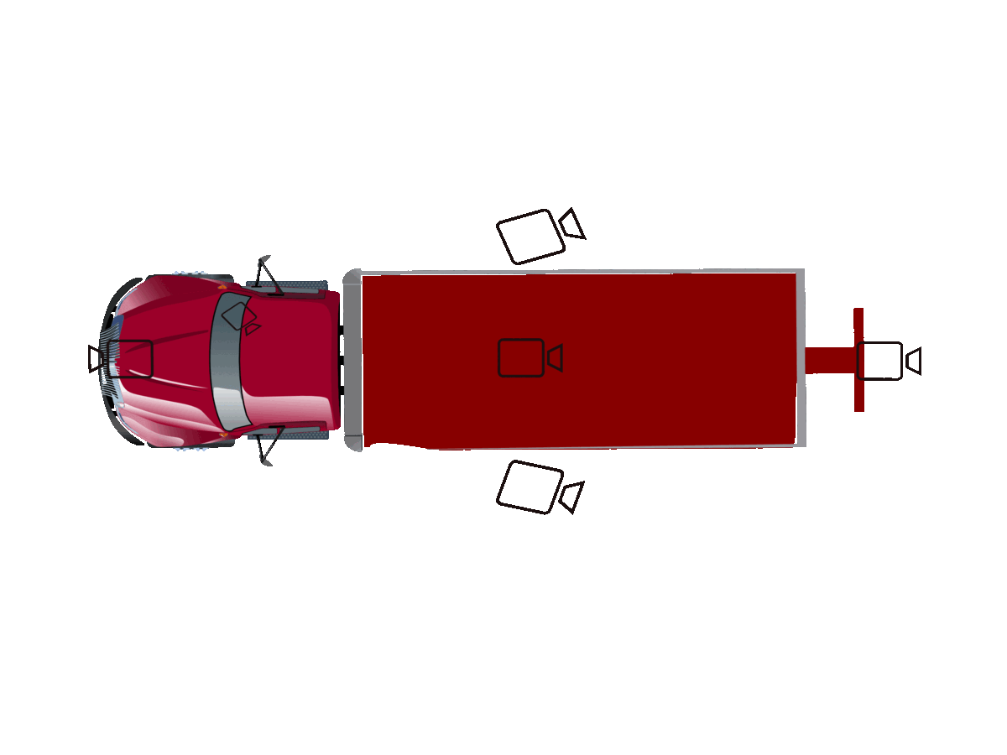
Mobile Video Computing’s multi-camera system provides the absolute best vehicle coverage area which includes front, rear, side and cab views. Competitors only have the front and cab, missing essential areas. Tow operators need this coverage for superior training, safety, and litigation protection.
Confidential

Slide 5

Why
Superior video coverage area
Up to 400 hours of on-board video storage
Remote live streaming, playback and download capable
Desktop, Web and Mobile App Access
Automatic Vehicle Ignition Recording
Exclusive Cloud-based Monitoring System
Easily search video records by vehicle, date, time, and GPS location
Feature | CruiseCam I | CruiseCam III
Front Camera | Standard | Standard
Right Side | Optional | Standard
Left Side | Optional | Standard
Winch Camera | N/A | Standard
Stinger Camera | Optional | Optional
Cab Camera | Optional | Optional
7" LED Monitor | Optional | Optional
Total Camera Capacity | 3 | 8
MDVR Storage (GB) | 512GB | 2TB
Video Hours | 175-340 | 350-400
1080P Capable Cameras | 1 | 4
720P AHD Capable Cameras | 2 | 4
GPS Logging | Yes | Yes
Igntion Activated | Yes | Yes
Live Stream Capable | Yes | Yes
Power Takeoff Sensing | Yes | Yes
CamCheck Monitoring Service | Yes | Yes
Web Portal Access | Yes | Yes
4G LTE Cellular | Yes | Yes
SD Memory Card Slots | 2 Slots | N/A
Fleet Tracking | Yes | Yes
Cloud-based Platform | Yes | Yes
Alarm Settings | Yes | Yes
Tamper Resistant Access | Yes | Yes
Driver Event Logging Button | Yes | Yes
Confidential

Slide 6
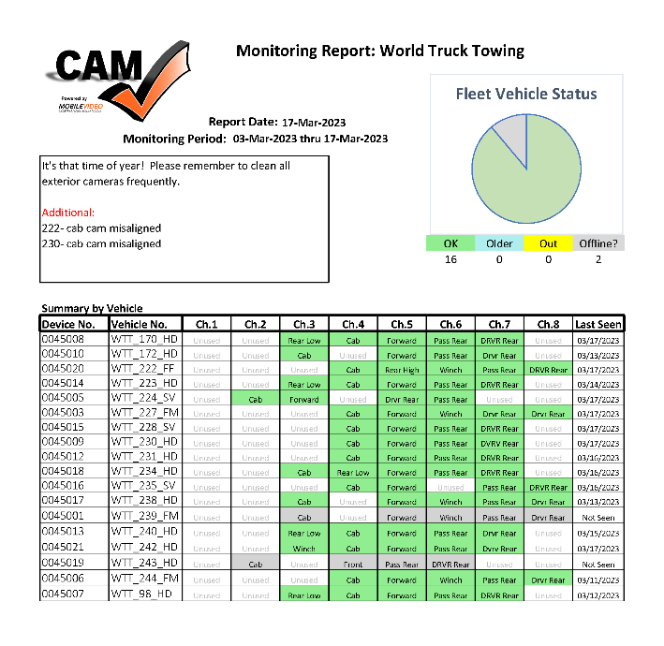
Monitoring Services
“It is not enough to have a camera – it has to be working!”
The harsh and hazardous operating conditions require regular operational monitoring to ensure reliable performance.
MVCS’s exclusive vehicle camera monitoring system – “pings” vehicle systems and scans cameras for any operational or maintenance issues and our team delivers proactive Reports & Alerts to Operators!
MVCS monitoring service provides weekly reports on camera and equipment conditions. Alerting the operators of any issues to reduce downtime.
Major Environmental & Operating Challenges
Dirt
Physical Obstructions
Misaligned Camera
Equipment Damage
Confidential

Slide 7
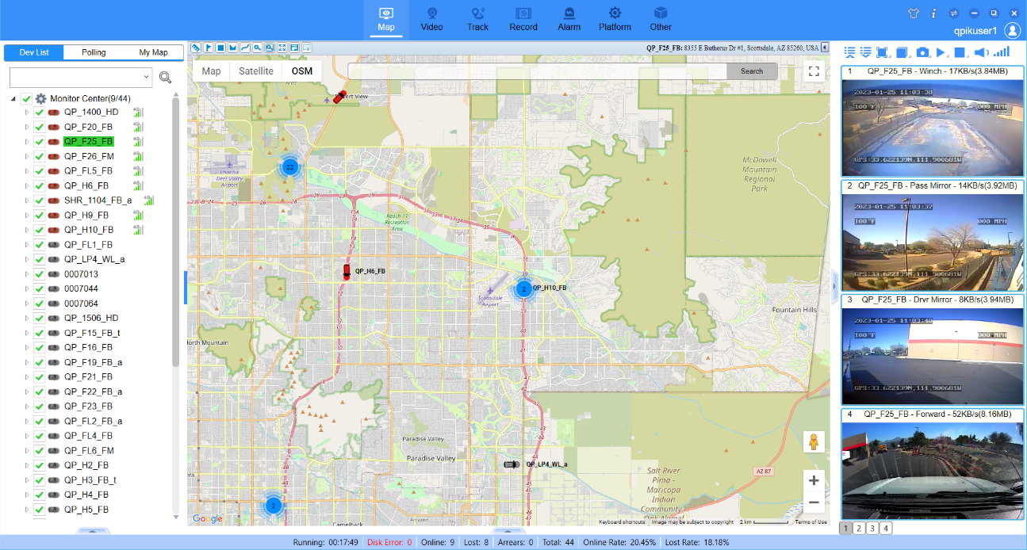

Cloud-based Services
Quickly access your vehicles video using our cloud-based platform.
Videos are automatically organized and tagged with GPS Location, date, time, and vehicle making searching content easy.
Live
Camera Feed
Vehicles
GPS positioning
Web, Desktop and Mobile App access to vehicle video content
Extract video remotely over internet.
Only download what you need.
View live streams
Easily see vehicle location and system status
Confidential

Slide 8
Components & Specifications
Confidential

Slide 9
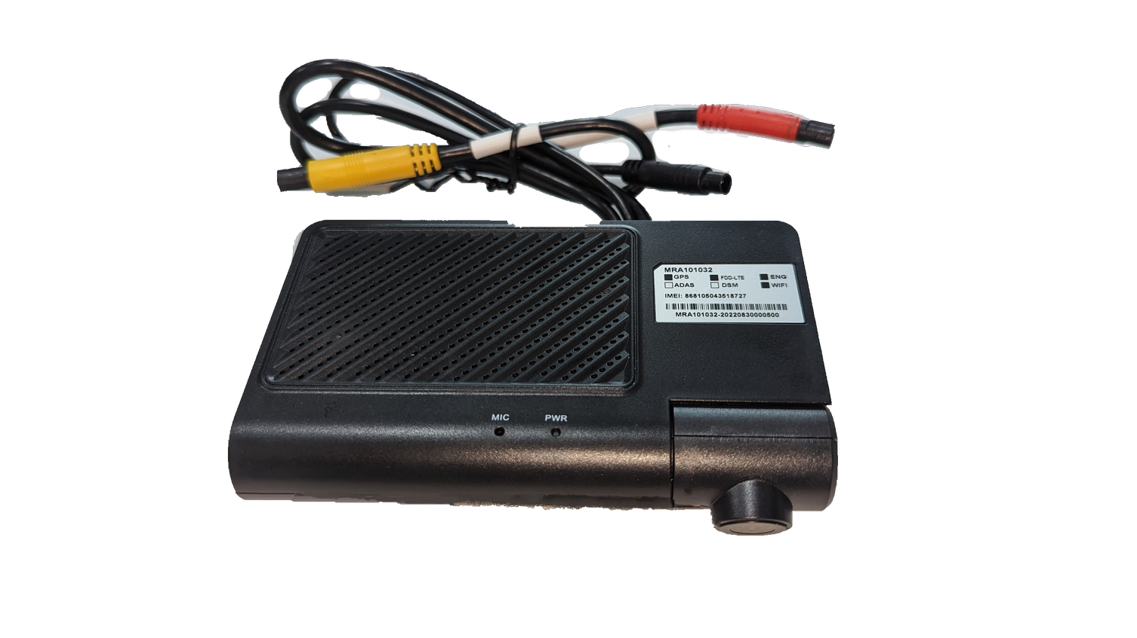
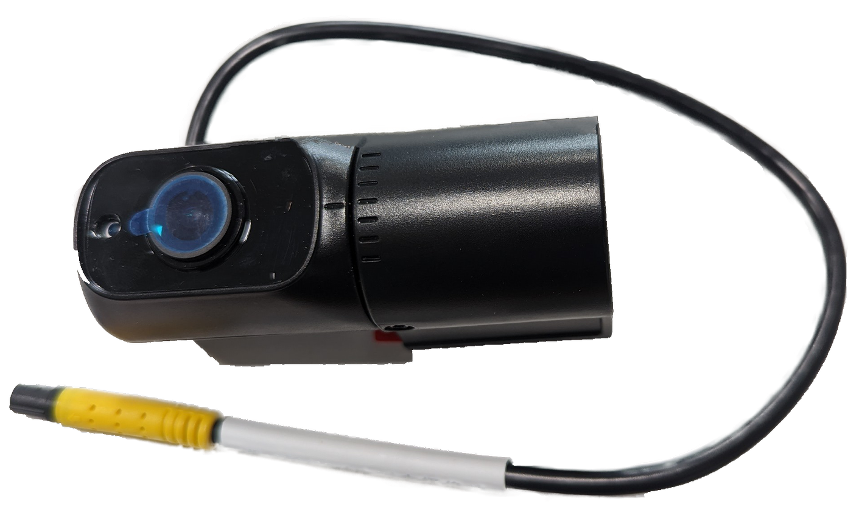
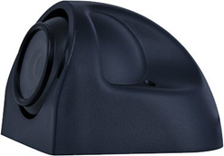
I - Components
720P Interior Camera
1080P Dashcam
720P Exterior Camera
Confidential

Slide 10
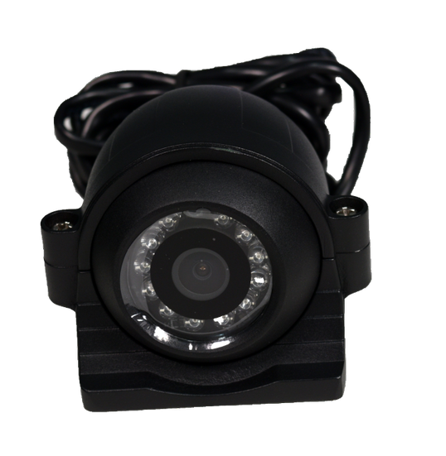
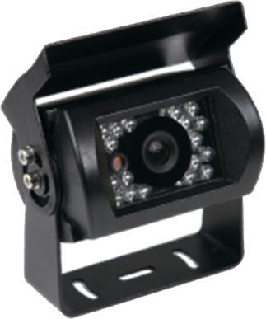
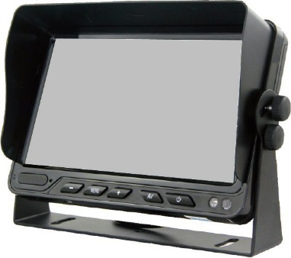
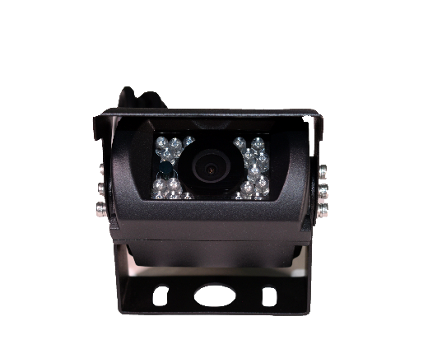
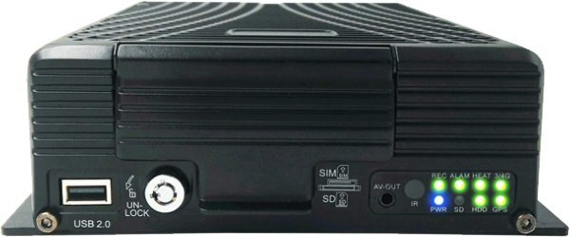
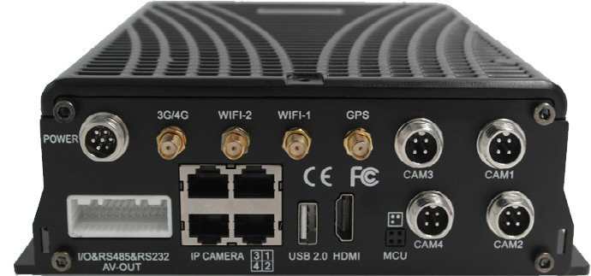
III - Components
Exterior Box HD IP Camera (wired)
Exterior Box AHD Camera (wired)
Exterior Eyeball 1080IP IPC(wired)
Interior HD IP Camera
7” LCD AHD Monitor
LTE, GPS, Smart Phone Integration
MDVR – Up to 4TB HDD/SDD
MDVR (rear)
Confidential

Slide 11
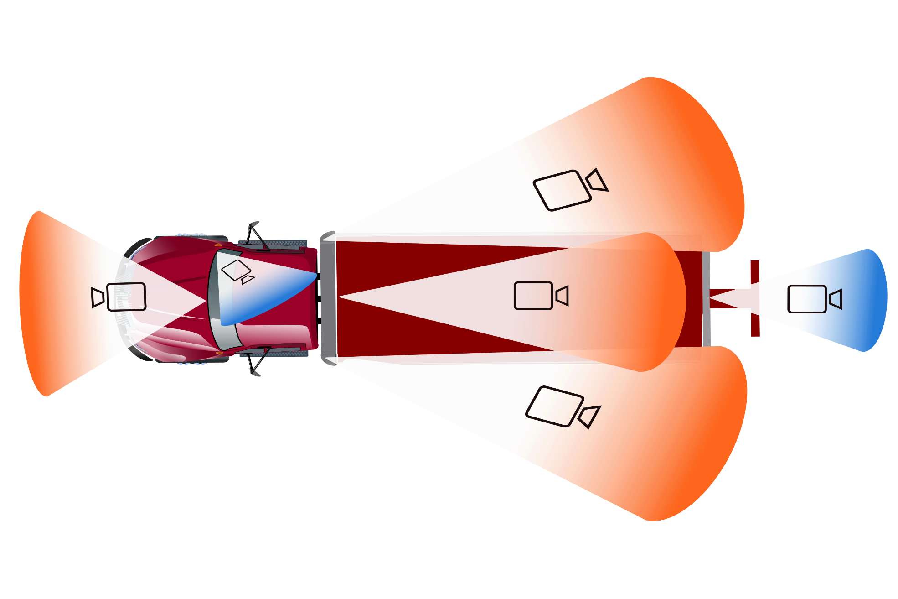
Camera Angles
Passenger’s Side Pylon View
Cab View (Optional)
Rear Camera View (Optional)
Forward View
Winch Camera View
Driver’s Side Pylon View
Confidential

Slide 12


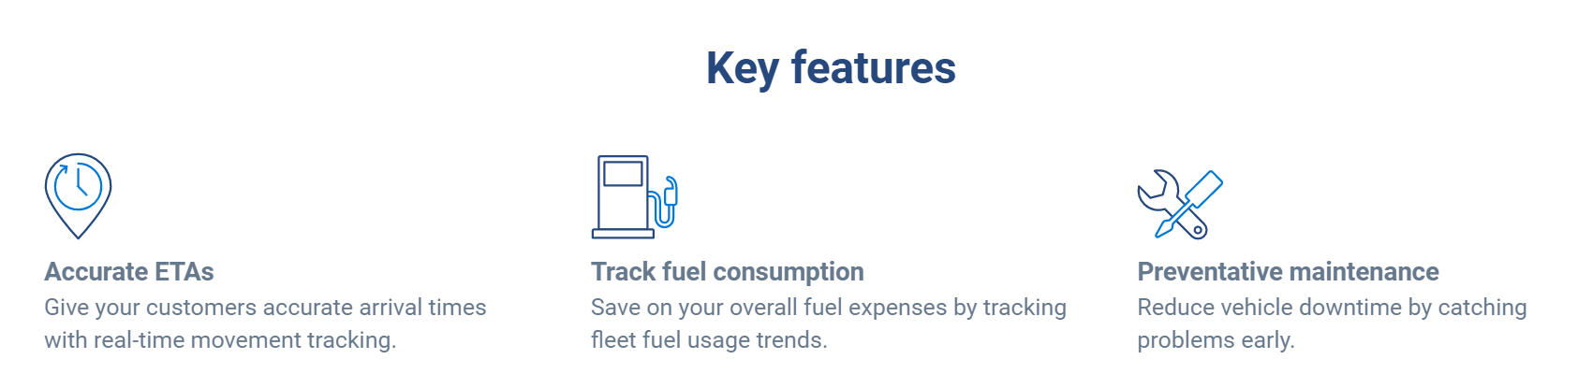
Confidential

Slide 13
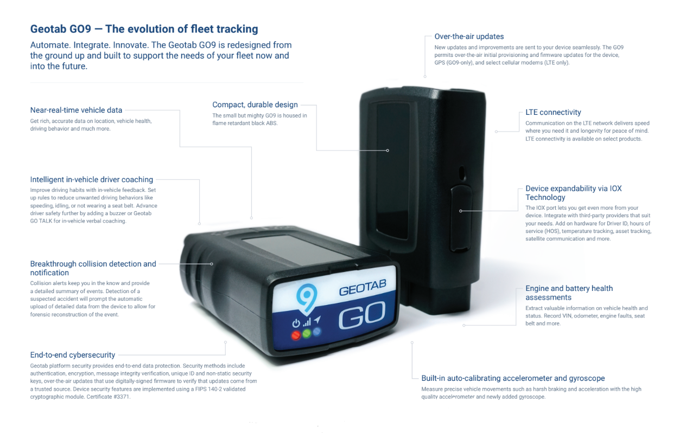
Confidential

Slide 14

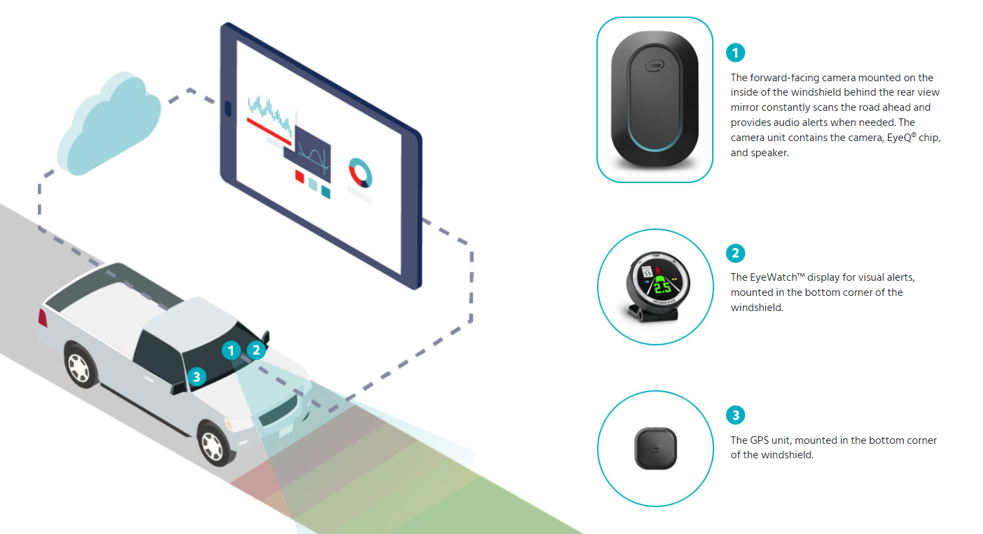
Official Installer & Reseller
Confidential

Slide 15

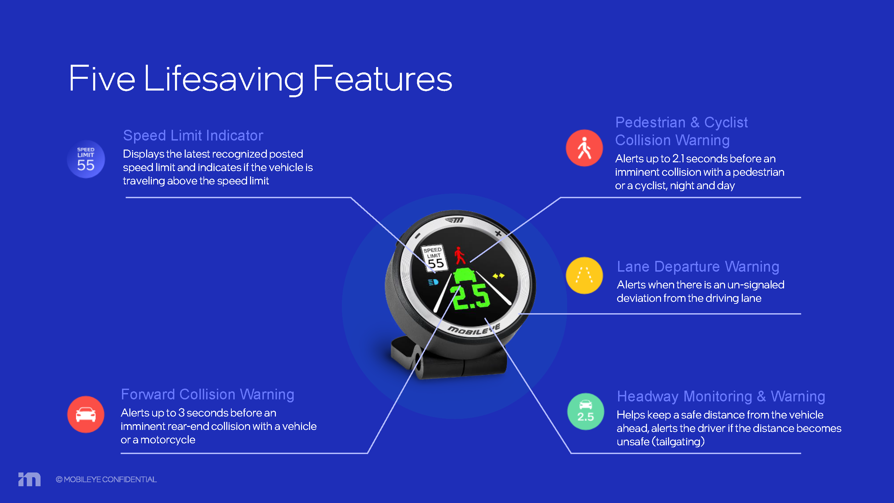
Confidential
Notes:
Please play in presentation mode

Slide 16
Questions & Answers
Confidential

Slide 17
Selling Points – CruiseCam™ Advantage
Ask yourself these questions:
  Have you experienced damage claims in the last year?
  Has your vehicle liability insurance increased within the last three years?
  Have you lost driver productivity by not monitoring behavior?
  Would it be helpful to see your vehicles plotted on a map and just click to see a live stream their actual video?
  Reviewing actual driver video can be a huge advantage in training and risk management, have you ever tried it?
Confidential

Slide 18
Contact:
Sales@mvcsol.com
(248) 817-6720 ext-1001
www.mvcsol.com
Copyright © 2023 Mobile Video Computing Solutions
Confidential

